Slide 1
DEMAND FORECASTING
30
JANUARY

Slide 2
01
PROJECT OBJECTIVE
Demand Forecasting: Anticipating future demand for a product

Slide 3

Introduction
Supply chain forecasting is the strategic process of predicting future demand for products or services, enabling organizations to optimize inventory levels, enhance efficiency, and meet customer needs with precision.
Supply chain forecasting is essential for optimizing inventory, reducing costs, enhancing customer service, improving decision-making, and mitigating risks, contributing to overall operational efficiency and market competitiveness.
This Photo by Unknown Author is licensed under CC BY-SA-NC

Slide 4

DEMAND FORECASTING
Demand forecasting is the practice of estimating future customer demand for a product or service. By analyzing historical data and market trends, businesses can make informed decisions to optimize their operations.

Slide 5
Techniques of DEMAND FORECASTING
A/B
Testing
Market Research
Time Series
Analysis
Econometric Models
Barometrics
Delphi
Method
Regression Analysis
Comp. Sales Force Approach

Slide 6
We Are Using The Statistical Approach
01
Time Series Analysis
Analyzing historical data to identify patterns and trends over time. Techniques include moving averages, exponential smoothing, and trend analysis.
02
Regression Analysis
Regression analysis for forecasting involves using mathematical models to examine the relationship between independent variables and a dependent. It helps predict future values based on historical data, making it a valuable technique in quantitative forecasting.

Slide 7
IMPORTANCE Of Demand Forecasting
Forecasting empowers businesses in planning resources
Improves Planning
Accurate demand forecasting leads to cost savings in inventory management.
Reduced Costs
Helps Managing Inventory
Demand forecasting prevents understocking and overstocking
Increased Customer Satisfaction
By predicting customer demand, businesses improves customer satisfaction

Slide 8
DATA OVERVIEW

Slide 9
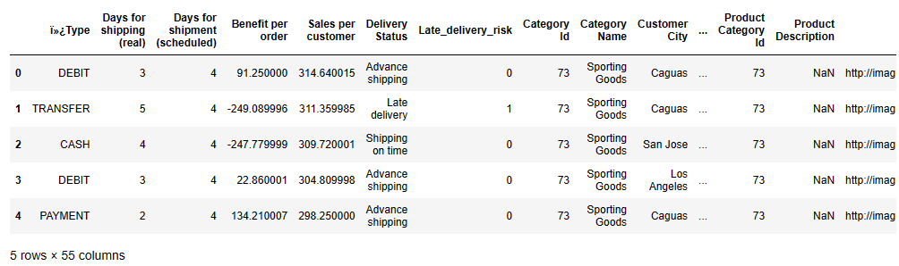
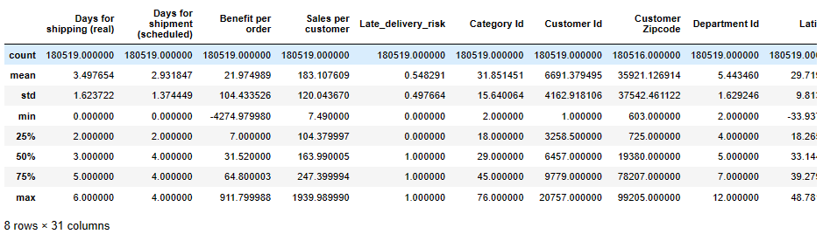
Rows : 180519
Columns : 55
Type of data:
Structured data

Slide 10
STEPS included in Model Training
1
2
3
4
5
6
7
Data Collection
Data Cleaning
Exploratory
Data Analysis
Feature Engineering
Model Selection
Model
Forecasting
Model Evaluation

Slide 11
—Data Visualization
Visualizing Demand Patterns : Utilizing graphs and charts and statistical measueres to identify trends seasonality and trend

Slide 12

A PICTURE IS WORTH A THOUSAND WORDS

Slide 13
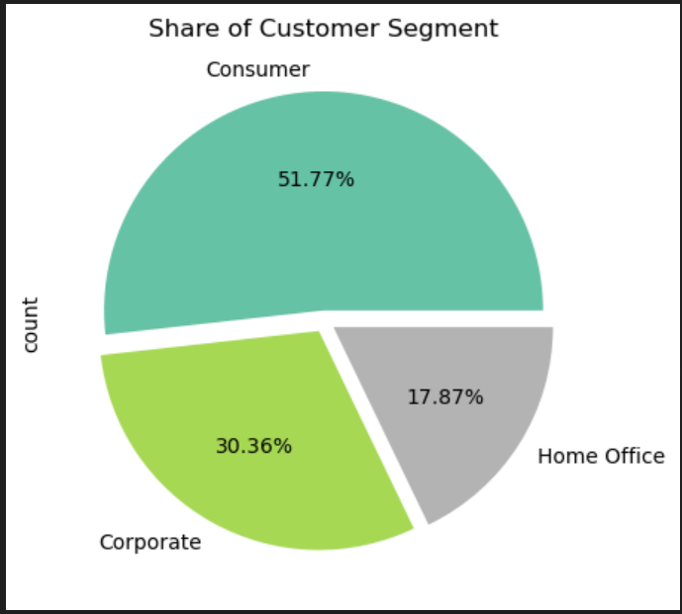
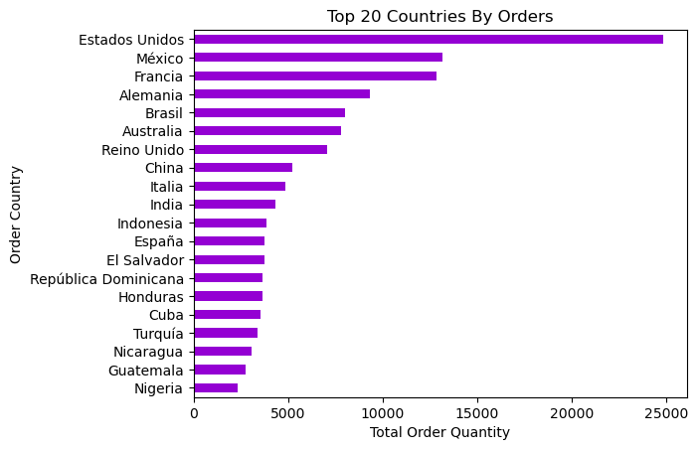
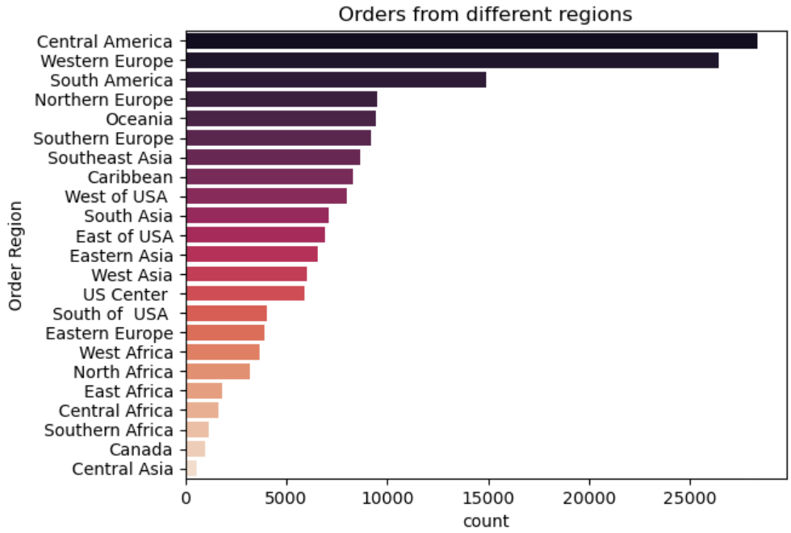
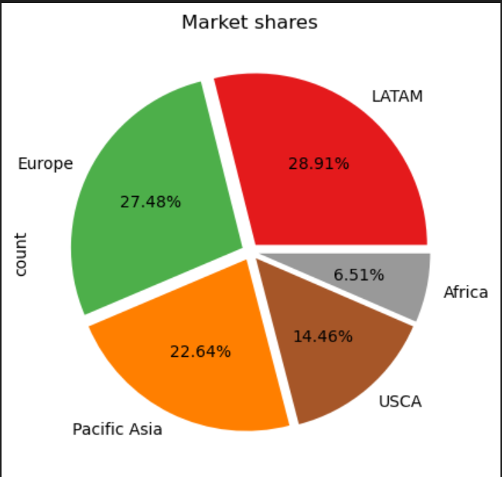

Slide 14
65.75 K
384 K
3.97 M
The Total Number of Orders
The Total Number of Demands
The Total amount of Profit

Slide 15

Model Selection
The selection of appropriate forecasting models is a critical decision in demand forecasting projects.

Slide 16
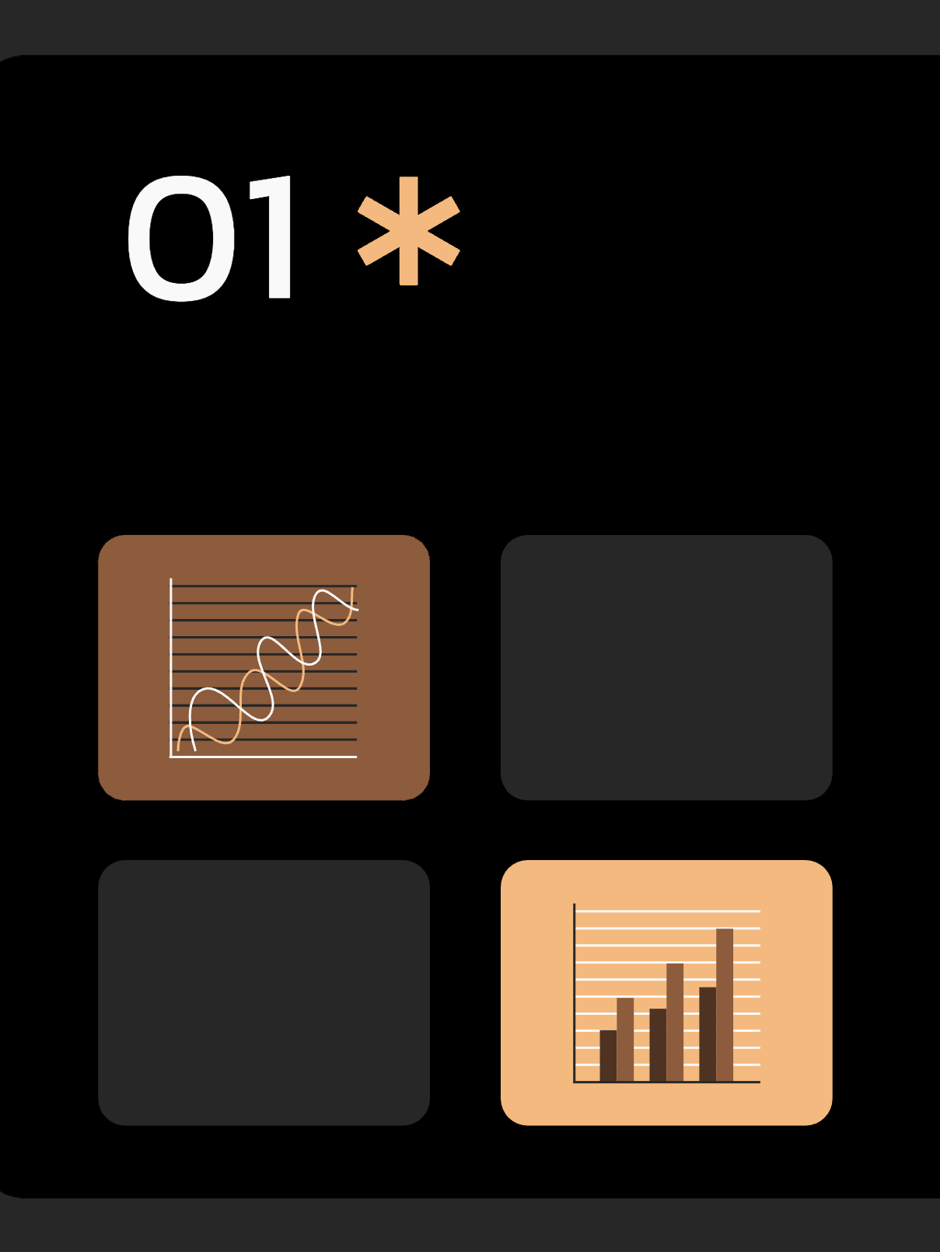
Forecasting Approach
This section focuses on discussing the application of time series models and regression techniques in demand forecasting

Slide 17
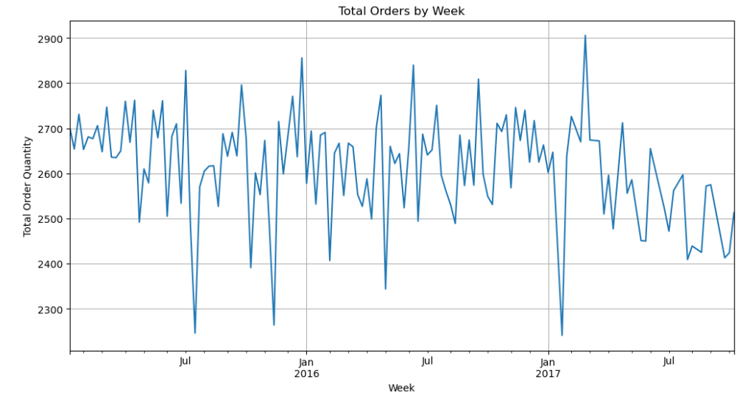
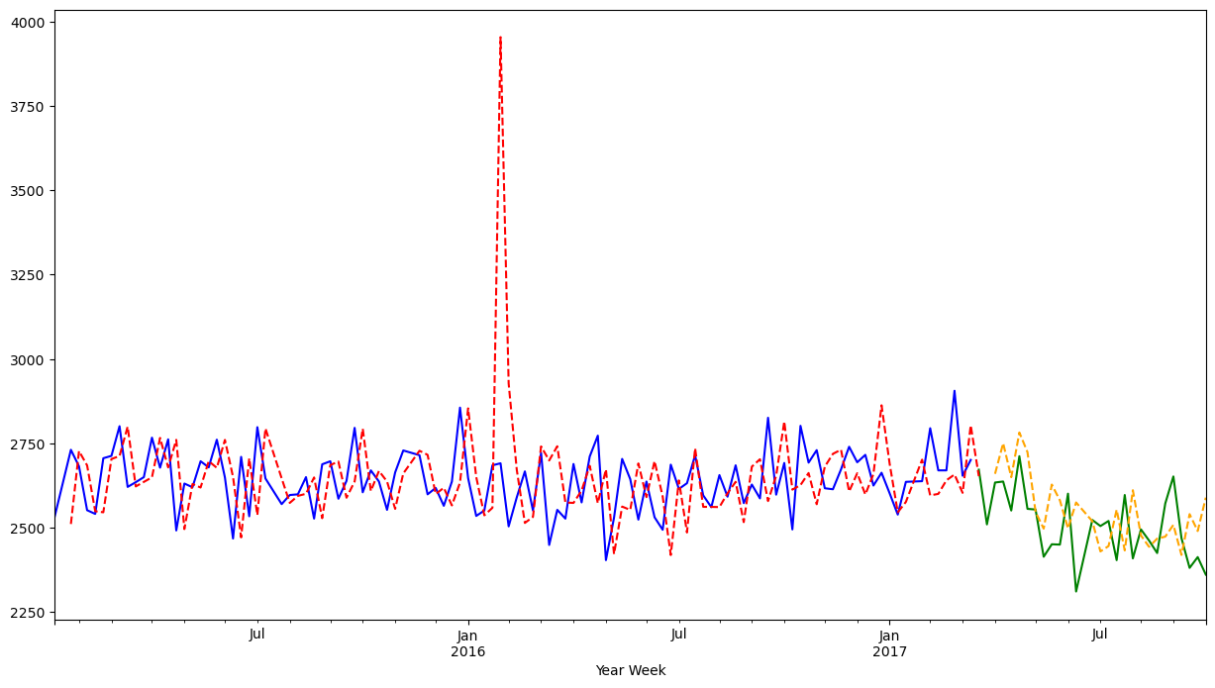
Utilizing Time Series Model

Slide 18
LET’S SEE SOME Models
25%
50%
75%
ARIMA
SARIMA
PROPHET
ARIMA focuses on Auto Regressive Integrated Moving Average
SARIMA extends ARIMA for seasonality
Prophet incorporates holidays and special events

Slide 19
Utilizing Regression Models
A regression model in forecasting utilizes mathematical relationships between independent and dependent variables to predict future outcomes, providing a quantitative approach to anticipate trends and make informed projections based on historical data. We used Linear Regression Model for forecasting

Slide 20
Forecasting Performance
 | MAE | MSE | RMSE | SMAPE
ARIMA | 93.6686 | 13160.893 | 114.72093 | 3.6393
SARIMA | 127.9846 | 23475.583 | 153.2174 | 4.9856
PROPHET | 125.9240 | 22291.582 | 145.1631 | 0.04780
LIN. REG. | 99.2566 | 14684.09 | 121.1779 | 3.8543

Slide 21
Interpretation from Model Performance
The performance metric used for Time Series Model is Symmetric Mean Absolute Error (SMAPE) . Smaller the value of SMAPE , better is the model. Here the performance of Prophet model overpass the performance of ARIMA and SARIMA model.
While the Regression model gives the best line fit for our data, it can not be good model to predict in comparison with Time Series Model.
Hence, we deduce that Prophet is model we should use for more accurate prediction.

Slide 22
INOVATIONS SHAPING DEMAND FORECASTING
1
Machine Learning
Utilizing algorithms and predictive analytics, machine learning can analyze vast amounts of data for accurate demand forecasts.
2
Big Data Integration
By incorporating external data sources and real-time information, businesses can improve the accuracy and timeliness of their forecasts.
3
Internet of Things
Connected devices provide real-time data on product usage, enabling businesses to adjust their forecasts based on actual consumption patterns

Slide 23
Findings Insights for Success
A demand forecasting project can provide several valuable learning insights for businesses. Here are key takeaways that organizations can glean from engaging in demand forecasting initiatives: Understanding of Seasonal Patterns, Customer Behavior Insights, Product Lifecycle Understanding, Effective Resource Allocation, Collaboration Across Departments, Strategic Decision-Making, Optimized Inventory Management, Continuous Improvement, Supply Chain Optimization, Integration of Technology etc.

Slide 24

Conclusion: Unlock Your Business's Potential
Demand forecasting is a vital tool that helps businesses navigate an ever-changing market landscape. By harnessing the power of anticipation, companies can drive growth, optimize operations, and stay one step ahead of the competition.

Slide 25
THANKS!
DO YOU HAVE ANY QUESTIONS?
Please keep this slide for attribution

Slide 26
References
01
02
03
What is Demand Forecasting? Importance and Benefits of Forecasting Customer Demand, mailto:https://www.shipbob.com/blog/demand-forecasting/
Project Report on Demand Forecasting, mailto:https://www.economicsdiscussion.net/project-report/project-report-on-demand-forecasting/21919#google_vignette
Slidesgo presentation template,
https://slidesgo.com/

